Slide 1
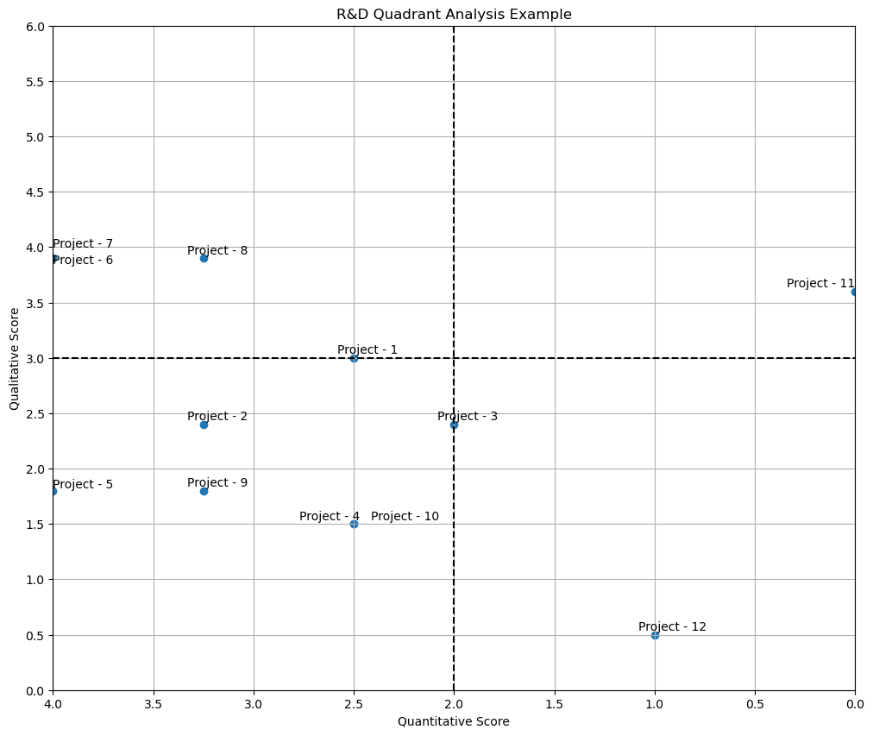
R&D Quadrant Analysis
Y-Axis = Qualitative Score
X-Axis = Quantitative Score
Quad 1: Invest
(High Qualitative Score, High Quantitative Score)
Recommendation: Sustain or increase spend
Quad 2: Optimize
(High Qualitative Score, Low Quantitative Score)
Recommendation: Optimize operational efficiency and/or reduce spend
Quad 3: Optimize
(Low Qualitative Score, High Quantitative Score)
Recommendation: Optimize operational efficiency and/or reduce spend
Quad 4: Scale Back
(Low Qualitative Score, Low Quantitative Score)
Recommendation: Cut or defer program
LOW to HIGH
HIGH to LOW

